Slide 1

Big Data Visual Analytics (CS 661)
Instructor: Soumya Dutta
Department of Computer Science and Engineering
Indian Institute of Technology Kanpur (IITK)
email: soumyad@cse.iitk.ac.in

Slide 2
Reading Materials for Lectures 1 & 2
Visualization Analysis and Design by T. Munzner
Chapter 1, Chapter 2, Chapter 5
Book available online at IITK Library
Reading Materials for Lecture 3 (Today)
The Visualization Toolkit by Will Schroeder, Ken Martin, Bill Lorensen
Chapter 1, Chapter 4, Chapter 5
Get the pdf: https://vtk.org/vtk-textbook/
Reference for learning VTK:
VTK User’s Guide
Get the pdf: https://vtk.org/vtk-users-guide/
Examples: https://kitware.github.io/vtk-examples/site/Python/

Slide 3
Announcements
If you are not part of HelloIITK course page, please email me with your IITK email ASAP
If you are not able to form a group for assignments, do it by tonight and update the google spreadsheet
I will assign the remaining students to groups of 2 randomly

Slide 4
Acknowledgements
Some of the following slides are adapted from the excellent course materials and tutorials made available by:
Prof. Han-Wei Shen (The Ohio State University)
Prof. Klaus Mueller (State University of New York at Stony Brook)
David DeMarle (Intel)

Slide 5
Scientific Data Analysis and Visualization

Slide 6
Imaging, Computer Graphics, and Visualization
Image processing
Computer Graphics
Visualization
Study of 2D pictures, or images
Transform, extract features
Analyze the data
Process of creating images using a computer
2D paint-and-draw
Sophisticated 3D rendering techniques
Process of exploring, transforming, and viewing data as images, and plots
Gain understanding and insight into the data
“the purpose of visualization is insight, not pictures” – Ben Shneiderman

Slide 7

Scientific Visualization (SciVis)
Technique for comprehending data & knowledge extraction from the results of simulations, computations, or measurements
Field in computer science that encompasses
data representation and processing algorithms
visual representations
user interface
other sensory presentation such as sound, touch, AR, VR
Relatively (new) domain of research (~ 36 years)
Formal inception in 1987 by US NSF
“Visualization in Scientific Computing” by McCormick et al.

Slide 8
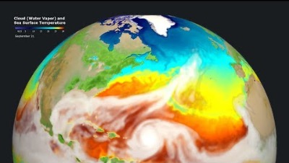
Example – Application in Climate Science
https://www.youtube.com/watch?v=8Df96rx3i9g

Slide 9
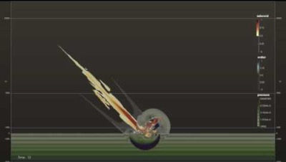
Example – Application in Asteroid Impact Assessment
https://www.youtube.com/watch?v=95z0qRNFFxs

Slide 10
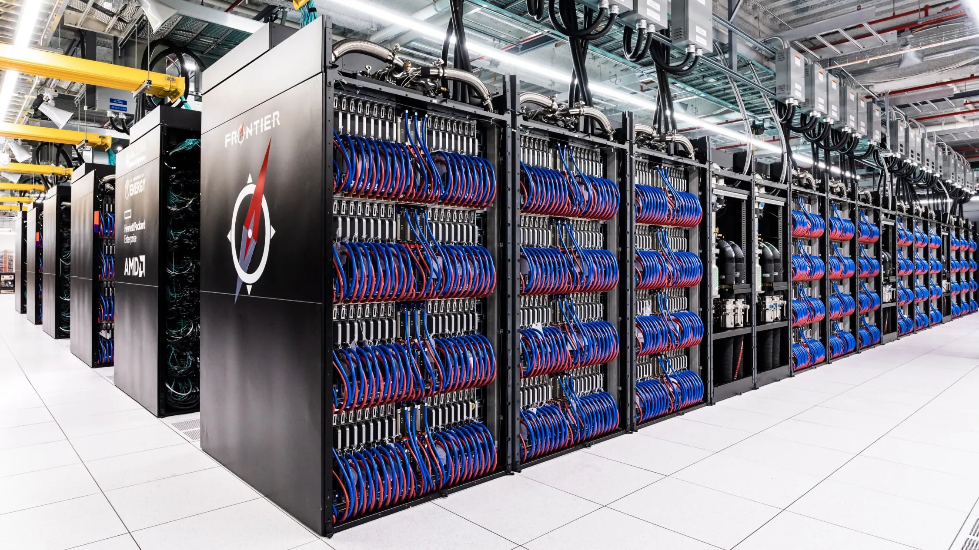
Big Data in Scientific Visualization
Big data describes datasets that are so large, complex, or rapidly changing that they push the very limits of our analytical capability¹
Megascale (10⁶ FLOPS) (1961)
Gigascale (10⁹ FLOPS) (1972)
Terascale (10¹² FLOPS) (1997)
Petascale (10¹⁵ FLOPS) (2009)
Exascale (10¹⁸ FLOPS) (2022)
FRONTIER World’s fastest supercomputer at Oak Ridge National Laboratory, credit: OLCF
¹NIST Big Data Public Working Group: (https://bigdatawg.nist.gov/_uploadfiles/NIST.SP.1500-1.pdf)

Slide 11
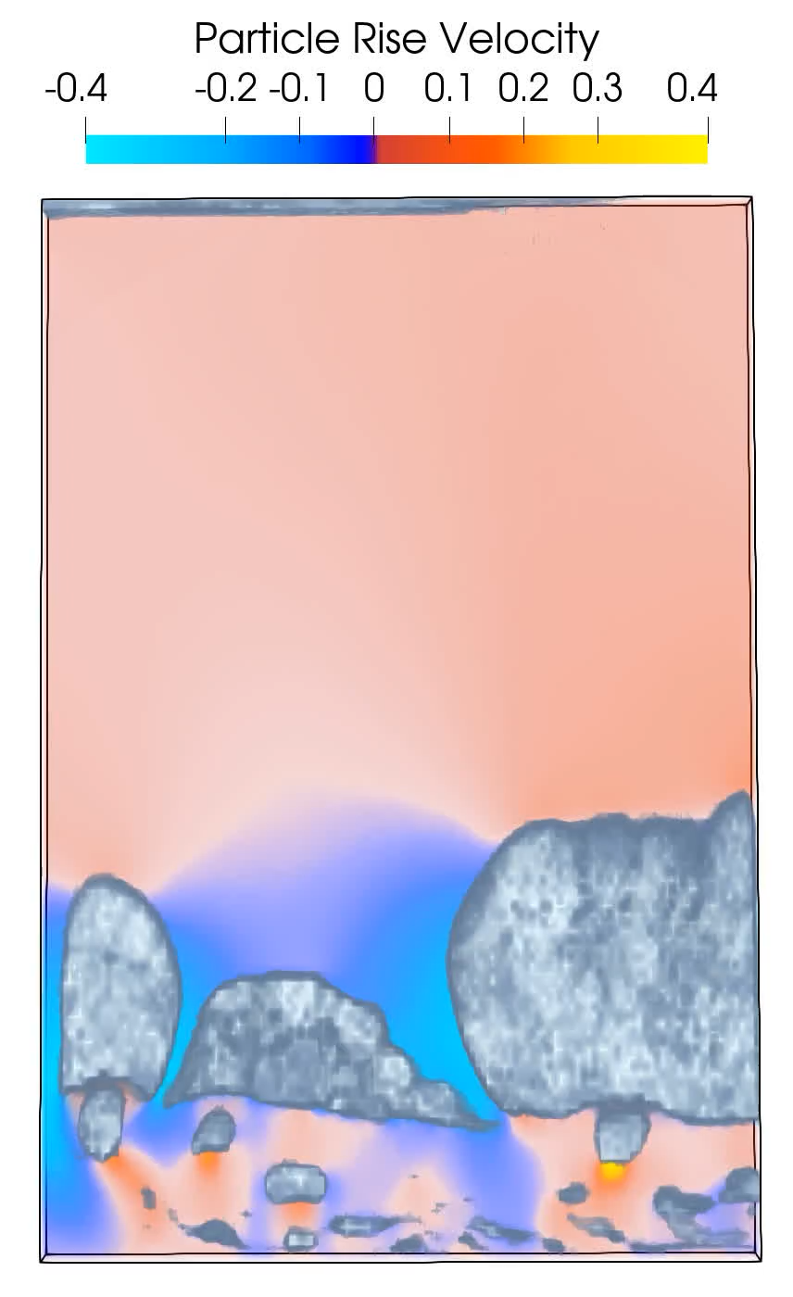

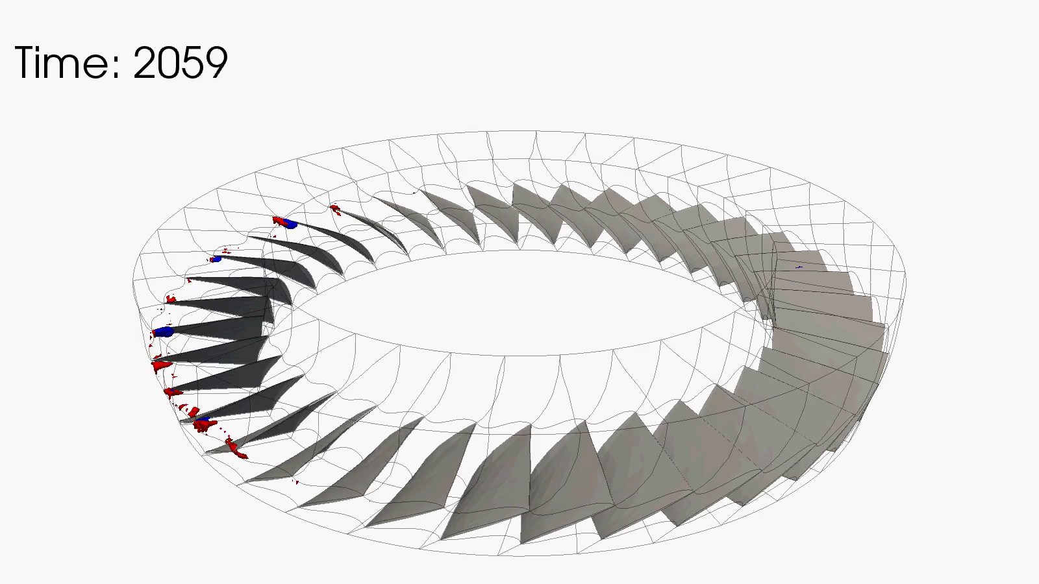
Big Data in Scientific Visualization
Exa-Star: Simulation of Universe
MFIX-Exa: Studies CLR
TURBO: Studies Engine Stall
The target science includes simulations of astrophysical explosions (such as supernovae and neutron stars) to understand the cosmic origin and the fundamental physics.
Deliver high-fidelity multiphase flow modeling capabilities for applications in reducing CO₂ emissions from fossil fuel power plants.
Enable understanding of rotating stall in Jet engines and develop stall detection as well as stall prevention measures.
Targeted to simulate 8192^3 resolution grid with 6 scalar quantities, i.e., 4TB per time step
The simulation will use billions of particles to model the physics. A simulation with 200 million particles and 100 time steps will need 160 TB storage.
Just a single revolution produces 5TB of data and hundreds of revolutions are needed to run.

Slide 12



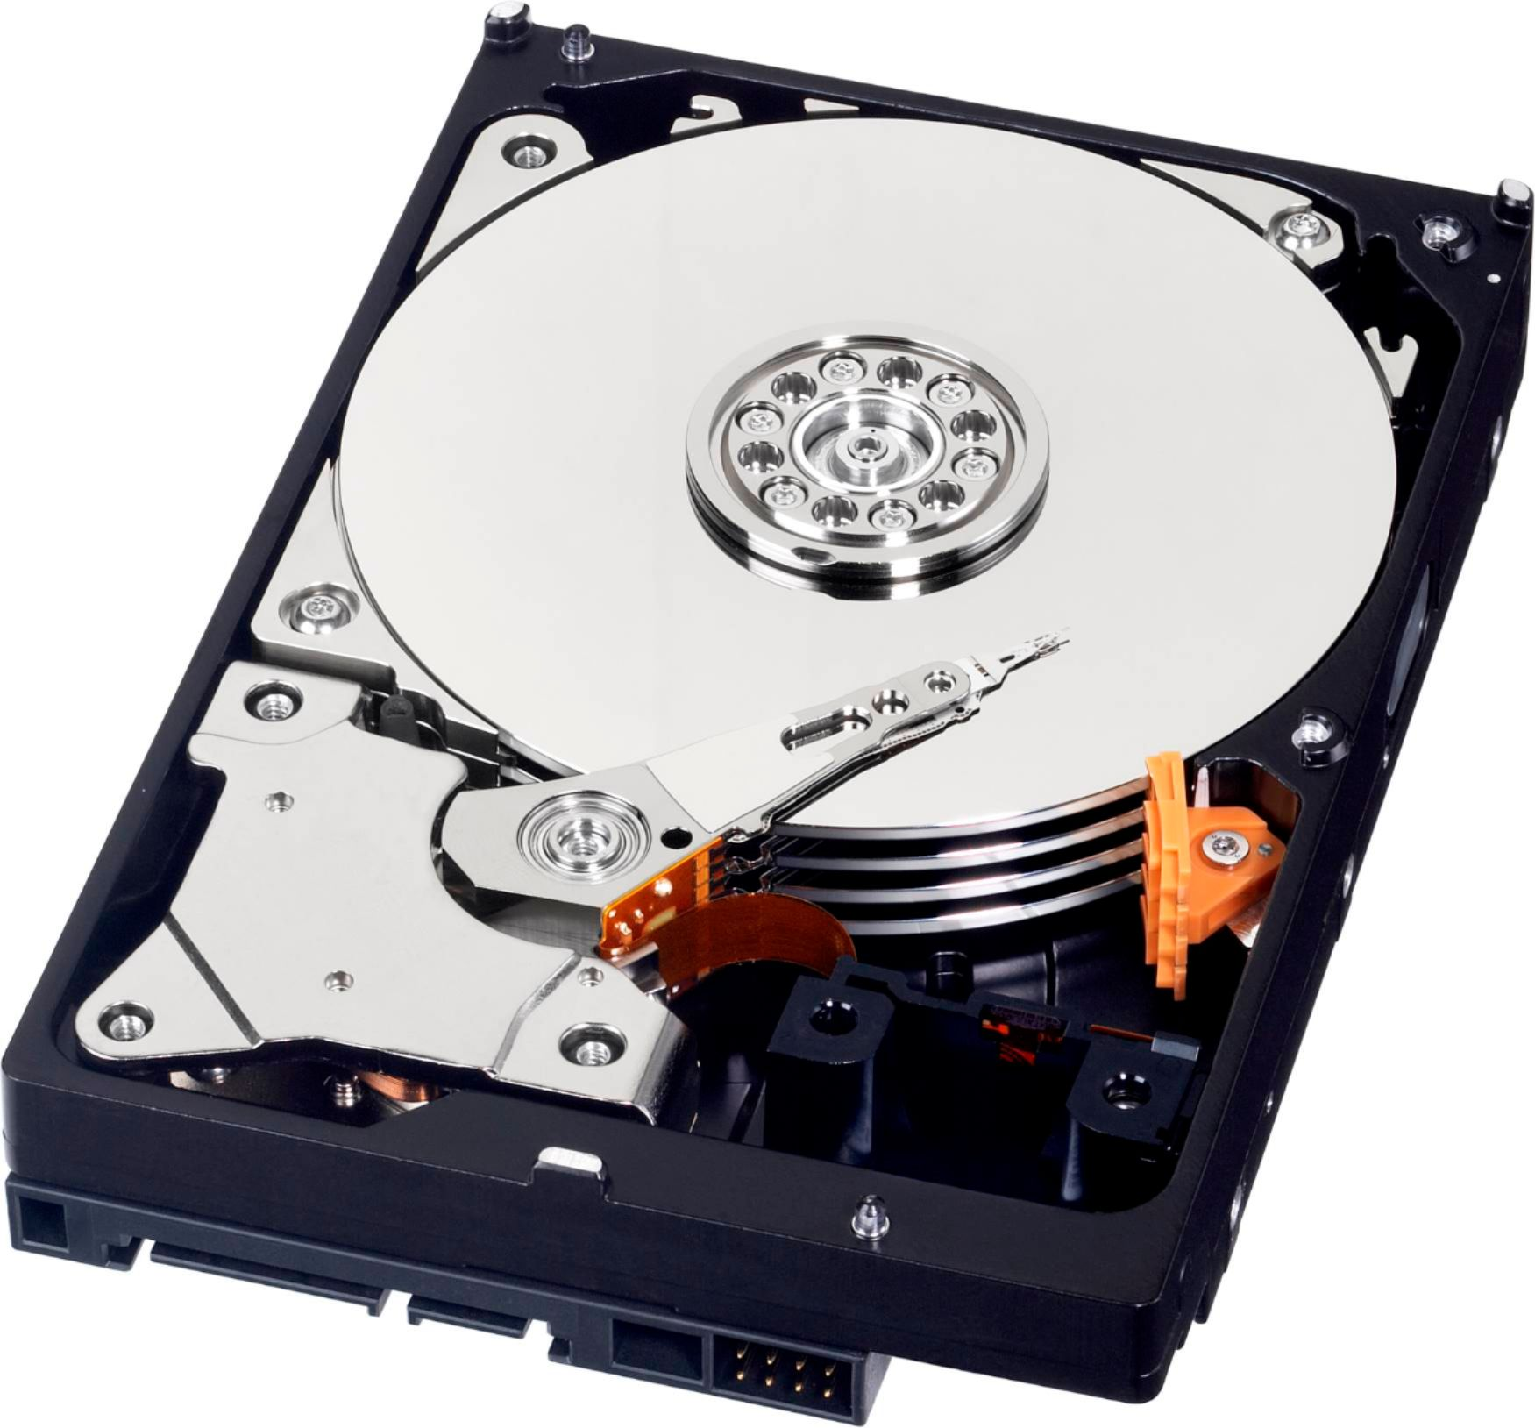




Big Data Characterization
The “5Vs” of Big Data
Velocity
Velocity: Rate at which data is generated
Volume: The extreme size of the data
Variety: Diverse types of structured and unstructured data
Veracity: Quality and truthfulness of the data
Value: Contributes to informed decision making
Value
Volume
Veracity
Variety

Slide 13
Big Data Characterization
The “5Vs” of Big Data
Velocity
Velocity: Rate at which data is generated
Volume: The extreme size of the data
Variety: Diverse types of structured and unstructured data
Veracity: Quality and truthfulness of the data
Value: Contributes to informed decision making
Value
Volume
Veracity
Variety
The 6th V: Visualization!

Slide 14
Visualization Pipeline

Slide 15
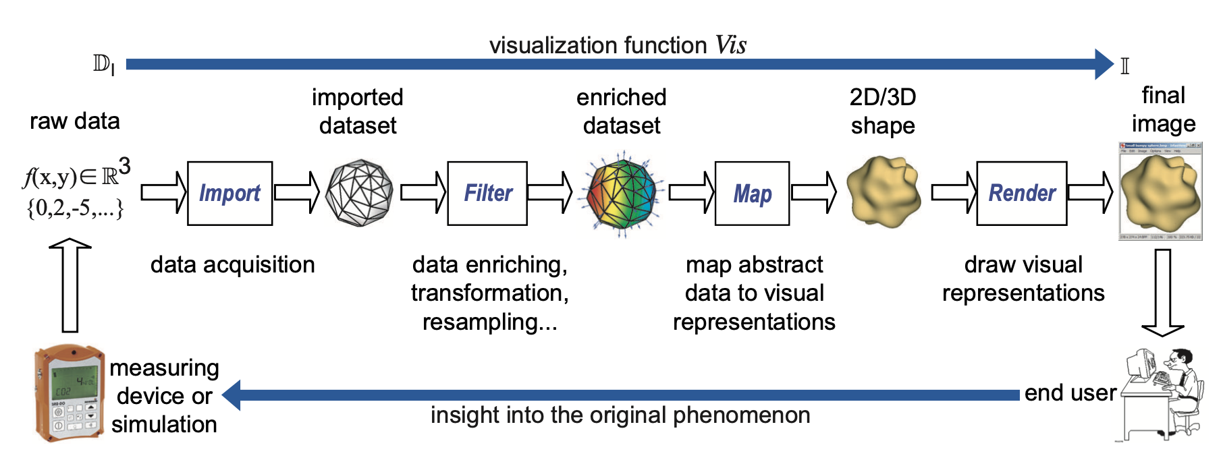
Visualization Pipeline

Slide 16
Visualization Pipeline

Slide 17
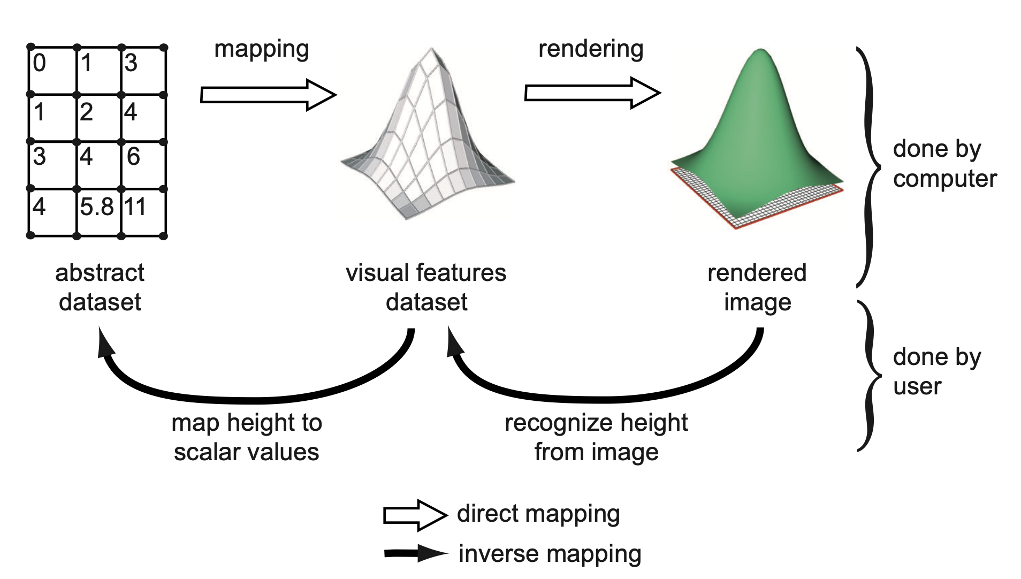
Direct and Inverse Mapping

Slide 18
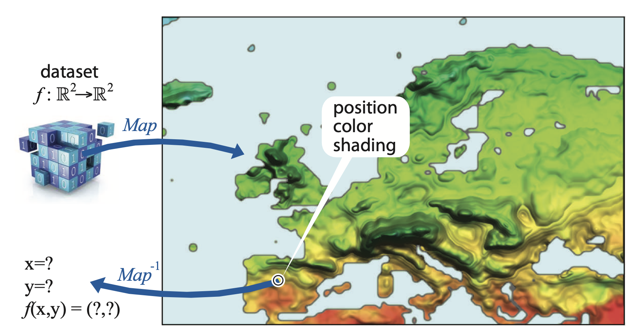
Direct and Inverse Mapping

Slide 19
Data Representation & Scientific Data Model

Slide 20
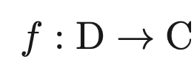
Data Representation
Scientific data is Continuous in nature
Measure of physical quantities that are studied by various disciplines
Mathematically, a continuous data is defined as a function
In practice, such data is sampled in a discrete form in computers for representation, manipulation, analysis, and visualization

Slide 21
Scientific Dataset
A scientific dataset is a related collection of data with a spatial context
In practice, we deal with discrete datasets sampled discretely from a continuous domain for digital representation

Slide 22
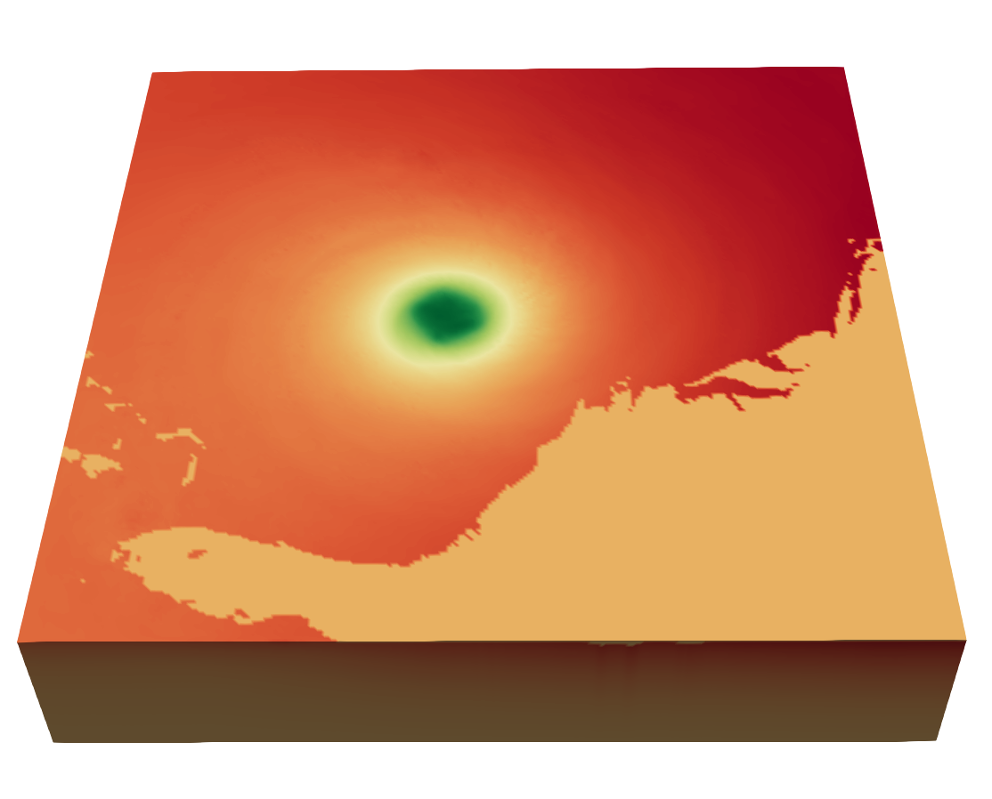
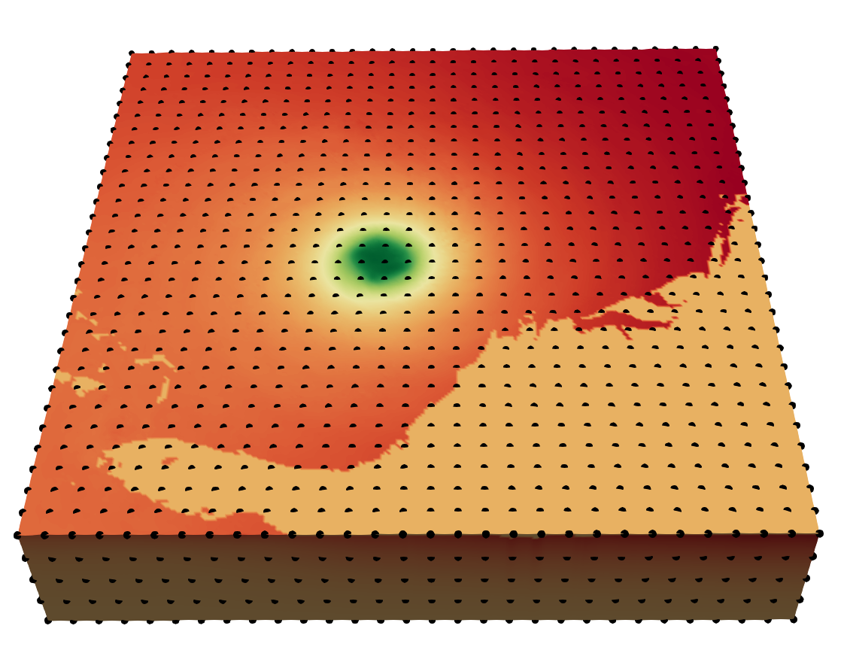
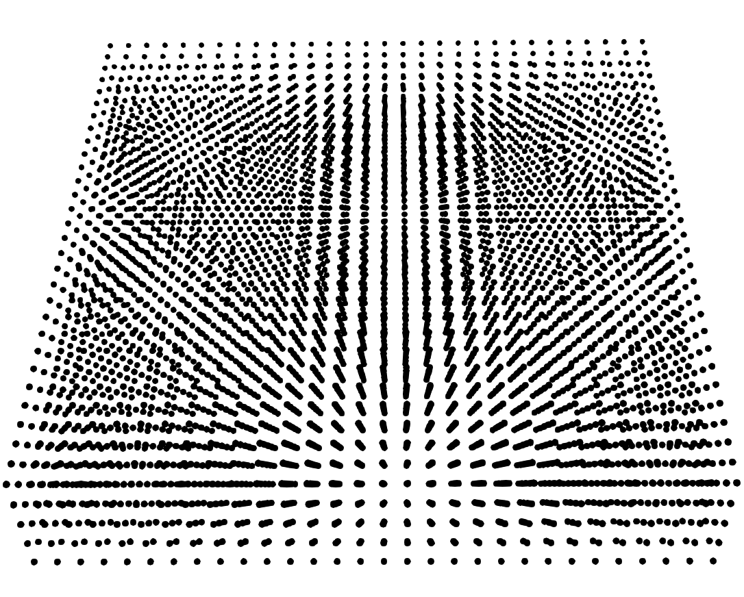

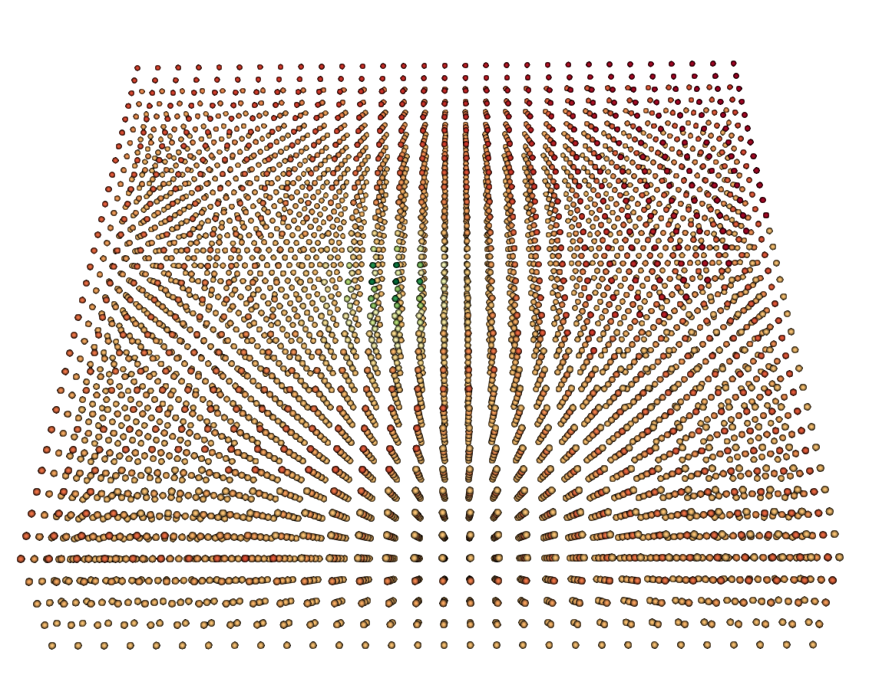
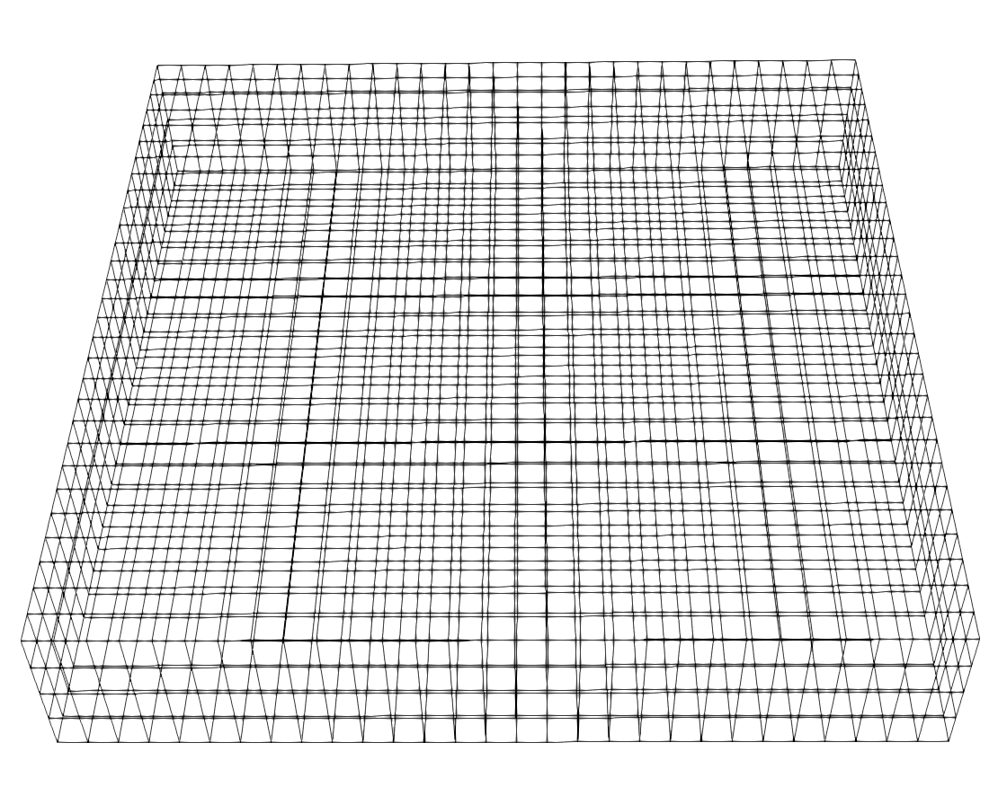
Scientific Dataset: Example
Continuous domain
Discrete samples
Discrete samples: Grid points
Reconstructed data from grid points
Data values are observed at grid points
Grid points connected to form cells

Slide 23
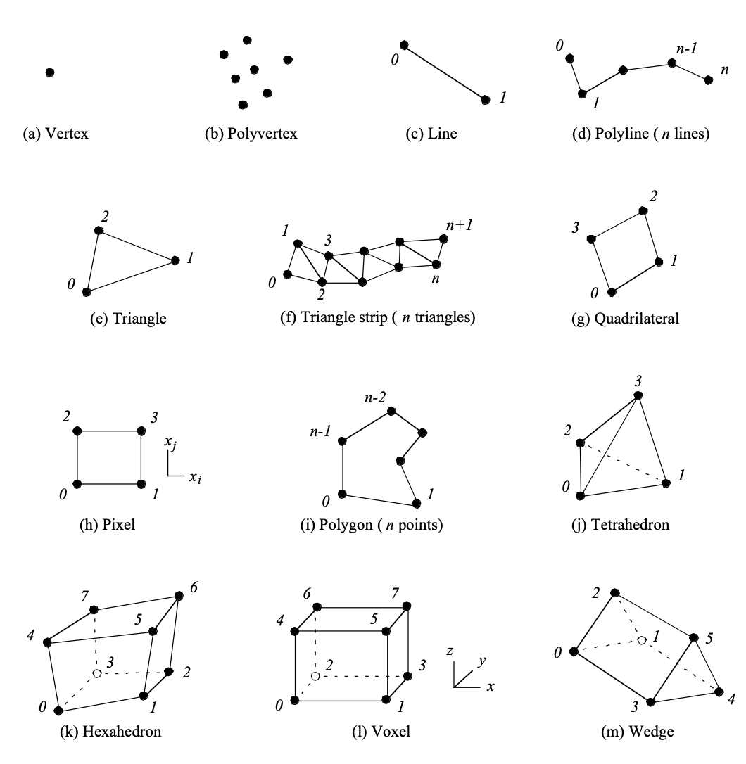
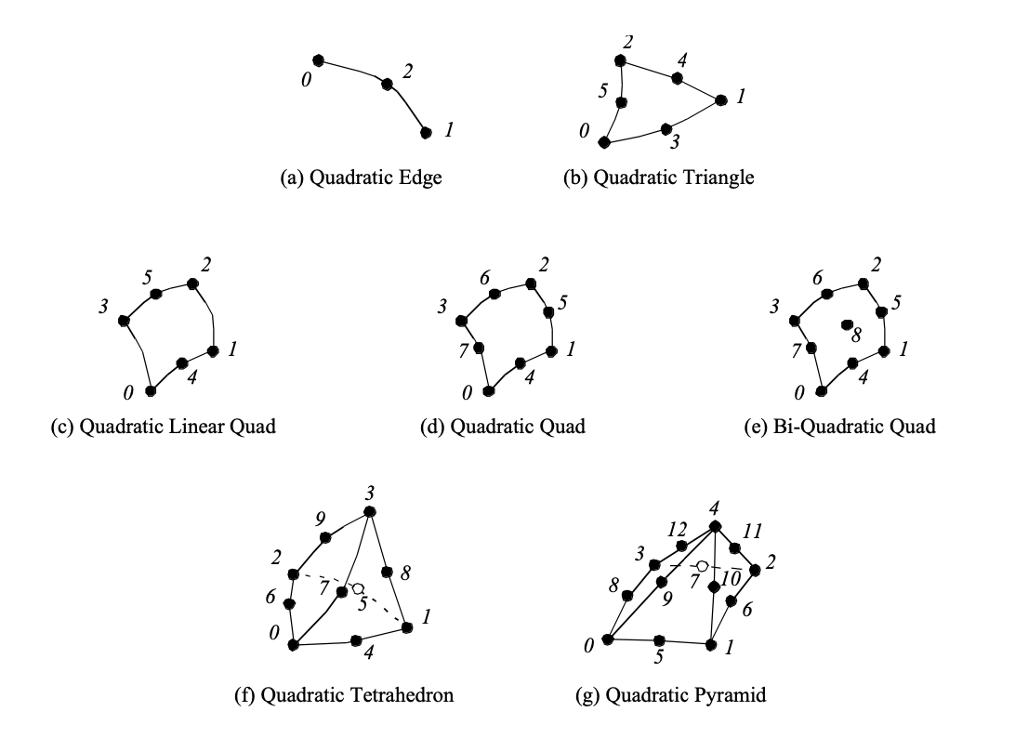
Scientific Dataset: Various Cell Types
Non-linear Cells Types
Linear Cell Types

Slide 24
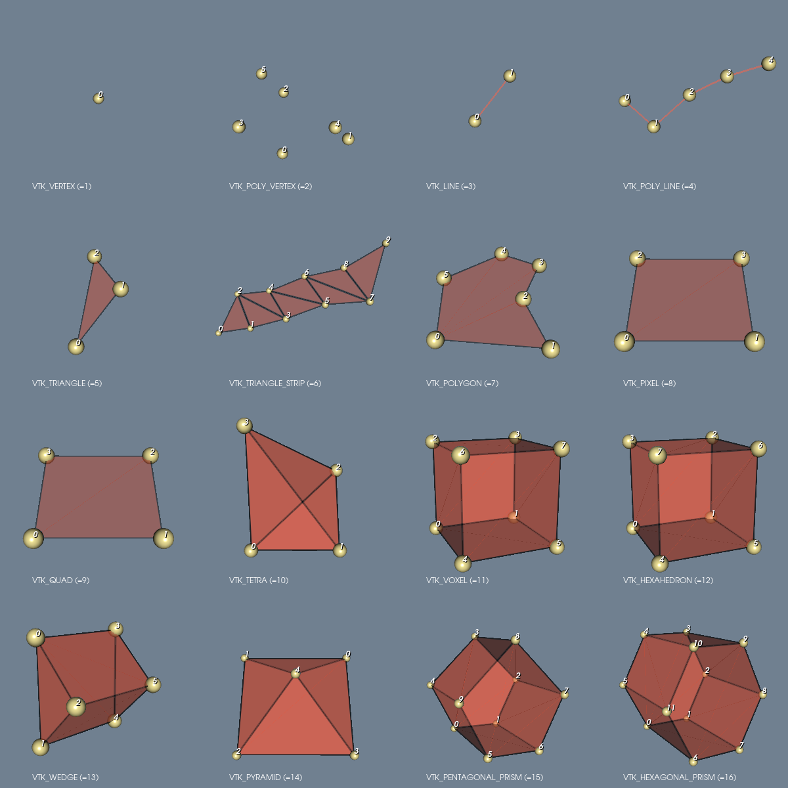
Demo Linear Cell
Code: https://kitware.github.io/vtk-examples/site/Python/GeometricObjects/LinearCellDemo/

Slide 25
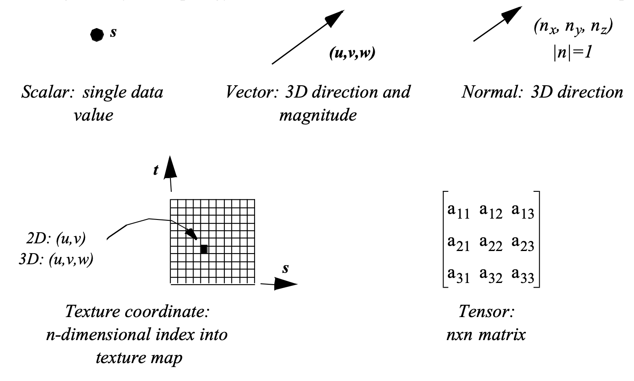
Scientific Dataset: Attribute Data

Slide 26
Scientific Dataset: Grid Types
Uniform grid
Rectilinear grid
Structured grid
Unstructured grid
Grid types

Slide 27
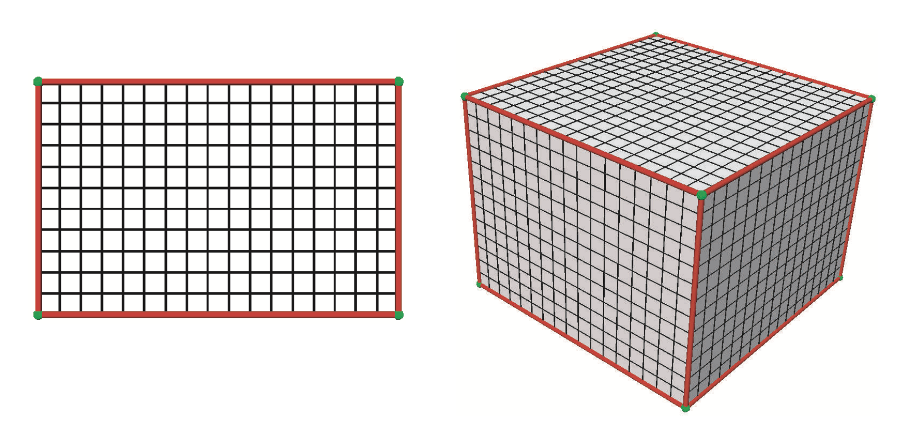
Scientific Dataset: Uniform Grid
Axis aligned box
Sample points are equally spaced

Slide 28
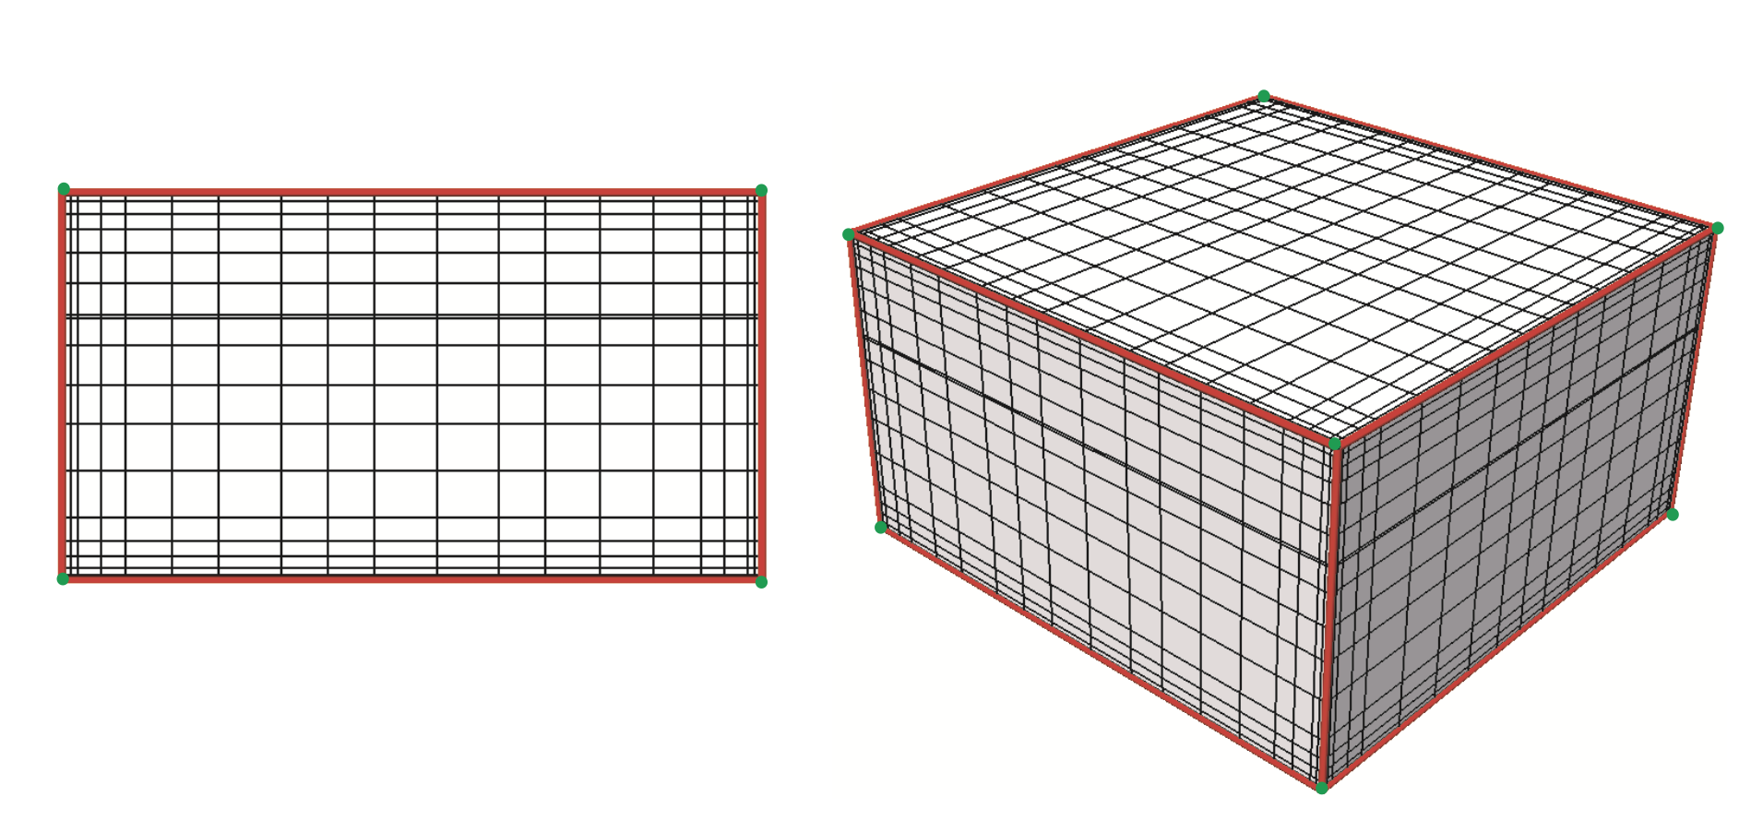
Scientific Dataset: Rectilinear Grid
Axis aligned box
Sample points are nonequally spaced

Slide 29
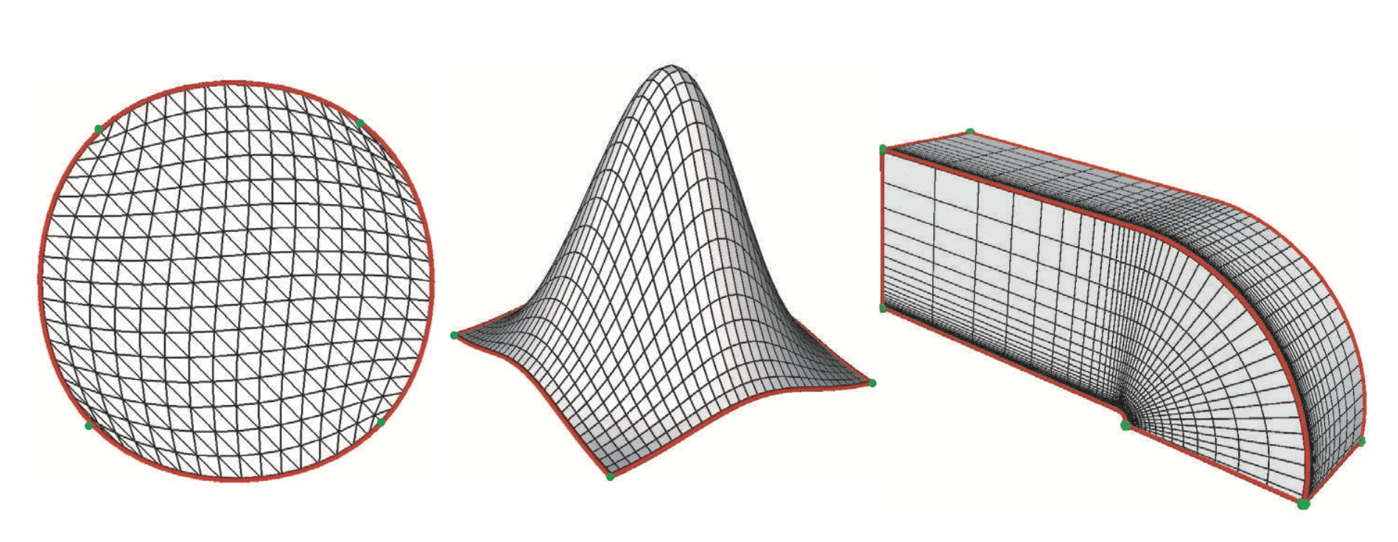
Scientific Dataset: Structured Grid
Allow explicit placement of every sample point
Yet preserve the matrix-like ordering
Structured grids can be seen as a deformation of uniform/rectilinear grids

Slide 30
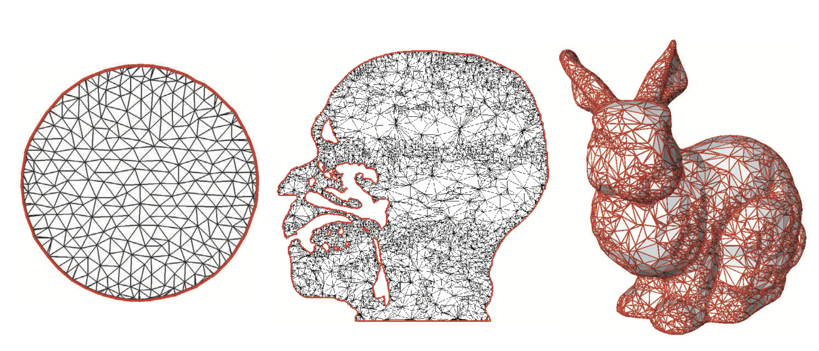
Scientific Dataset: Unstructured Grid
Allow us to define both the sample points and cells explicitly
Different cell types can be mixed
Connectivity is explicitly specified

Slide 31
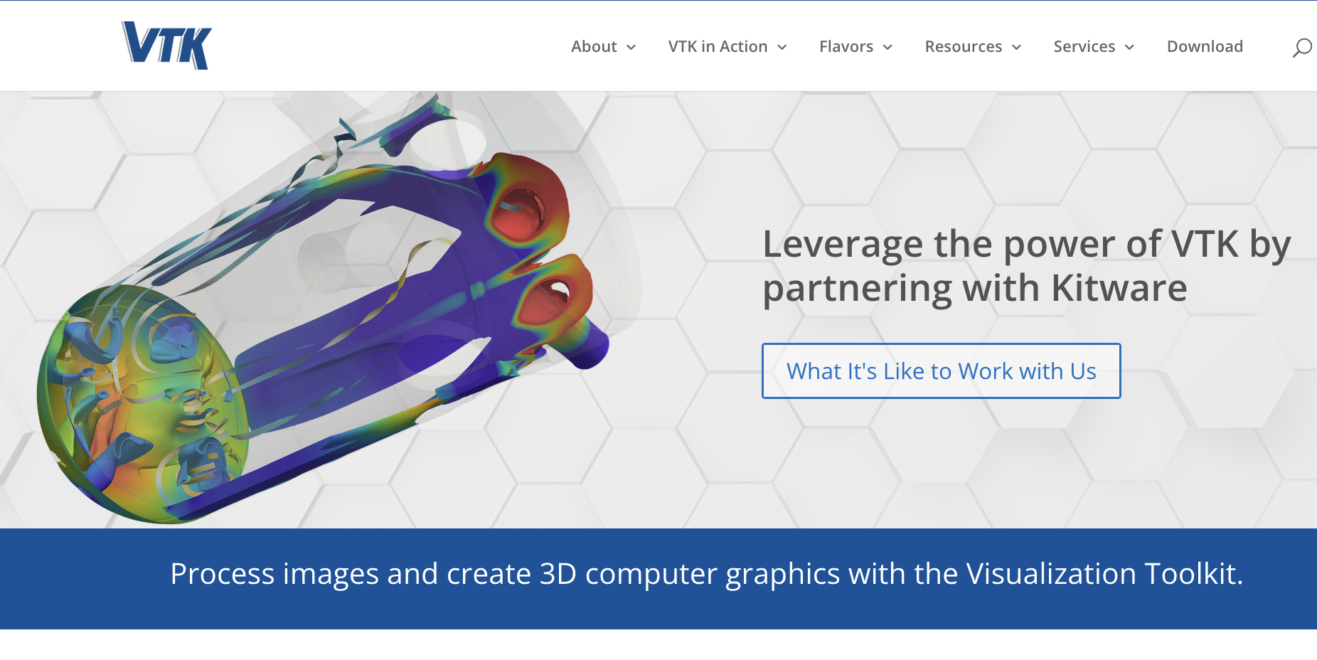
Visualization Toolkit (VTK)
https://vtk.org/

Slide 32
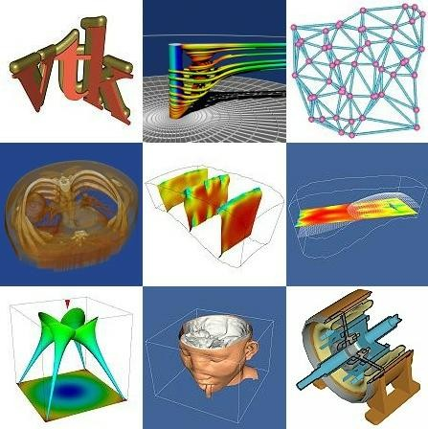
What is VTK?
VTK: Visualization Toolkit
An open source, freely available software library for 3D visualization, graphics, and image processing
Support for hundreds of algorithms
Object­‐oriented design with diﬀerent interpreted language wrappers.
Vtk.org

Slide 33
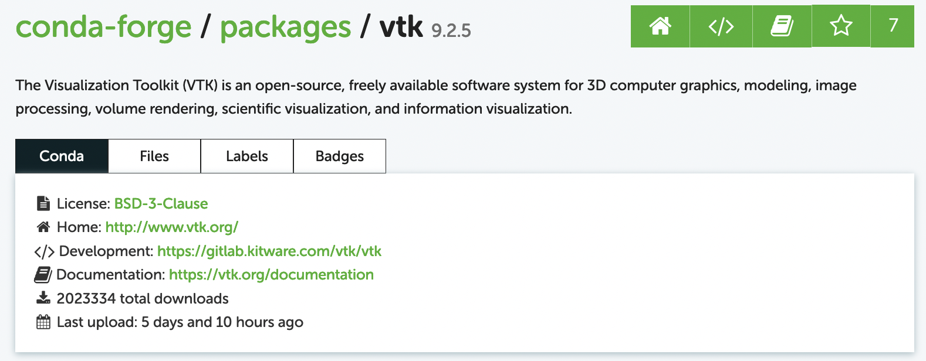
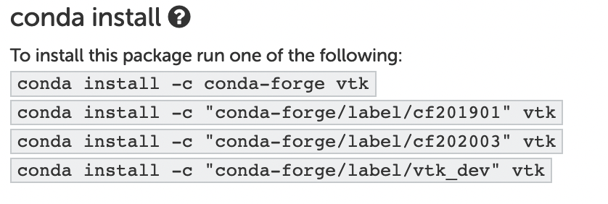
Installing VTK
https://anaconda.org/conda-forge/vtk
You can also use pip to install VTK

Slide 34
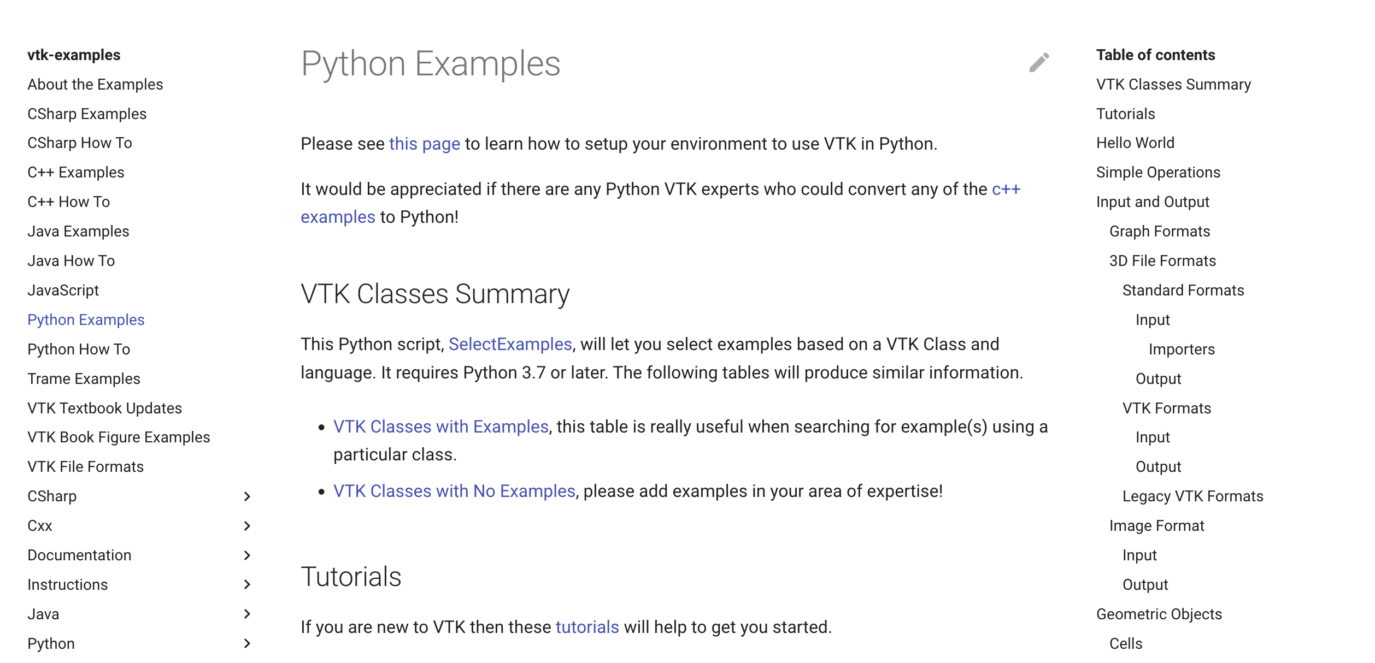
VTK: Resources
Examples: https://kitware.github.io/vtk-examples/site/Python/
VTK User’s Guide: https://vtk.org/vtk-users-guide/
VTK Textbook: https://vtk.org/vtk-textbook/

Slide 35
VTK System Architecture
Wrapper (Python, Java)
Tcl/Tk shell
Java interpreter
Python interpreter
Tcl/Tk source
Java JDK
Python source
C++ core
Libraries and includes (dll and .h files)
Or
(.a and .h files)
All class source code (could take hours to compile)
Binary Installation: if you will use the classes to build your applicatoin
Source code Installation: If you want to extend vtk

Slide 36
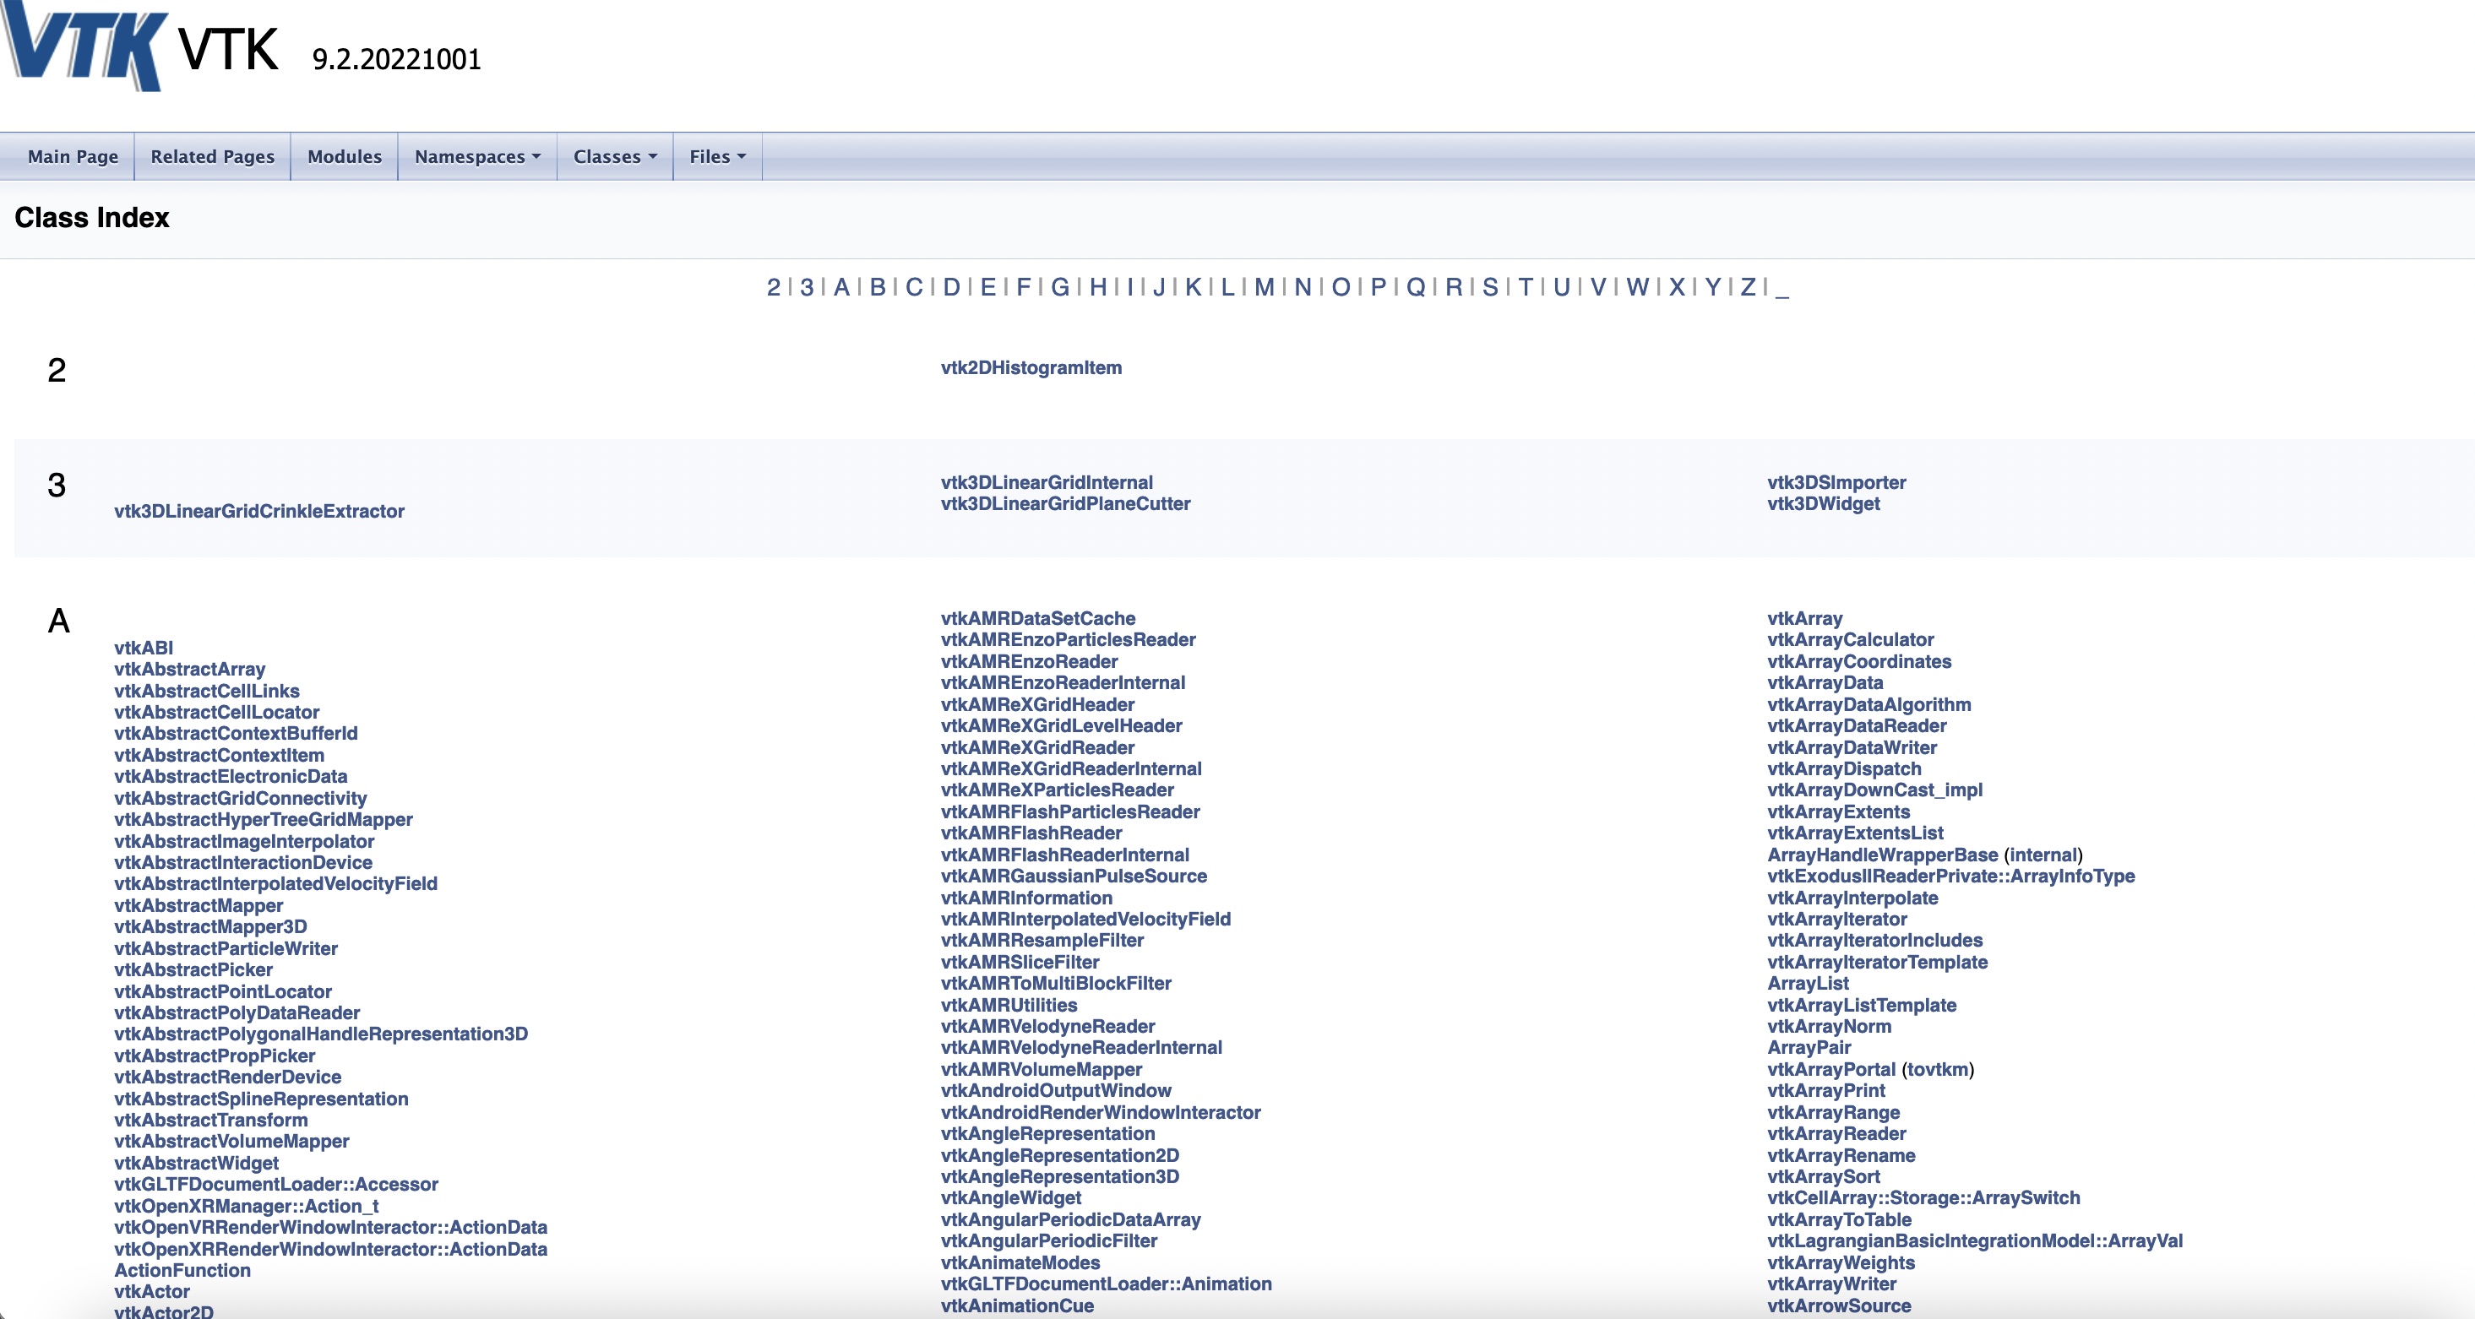
VTK classes
(https://vtk.org/doc/nightly/html/classes.html)

Slide 37
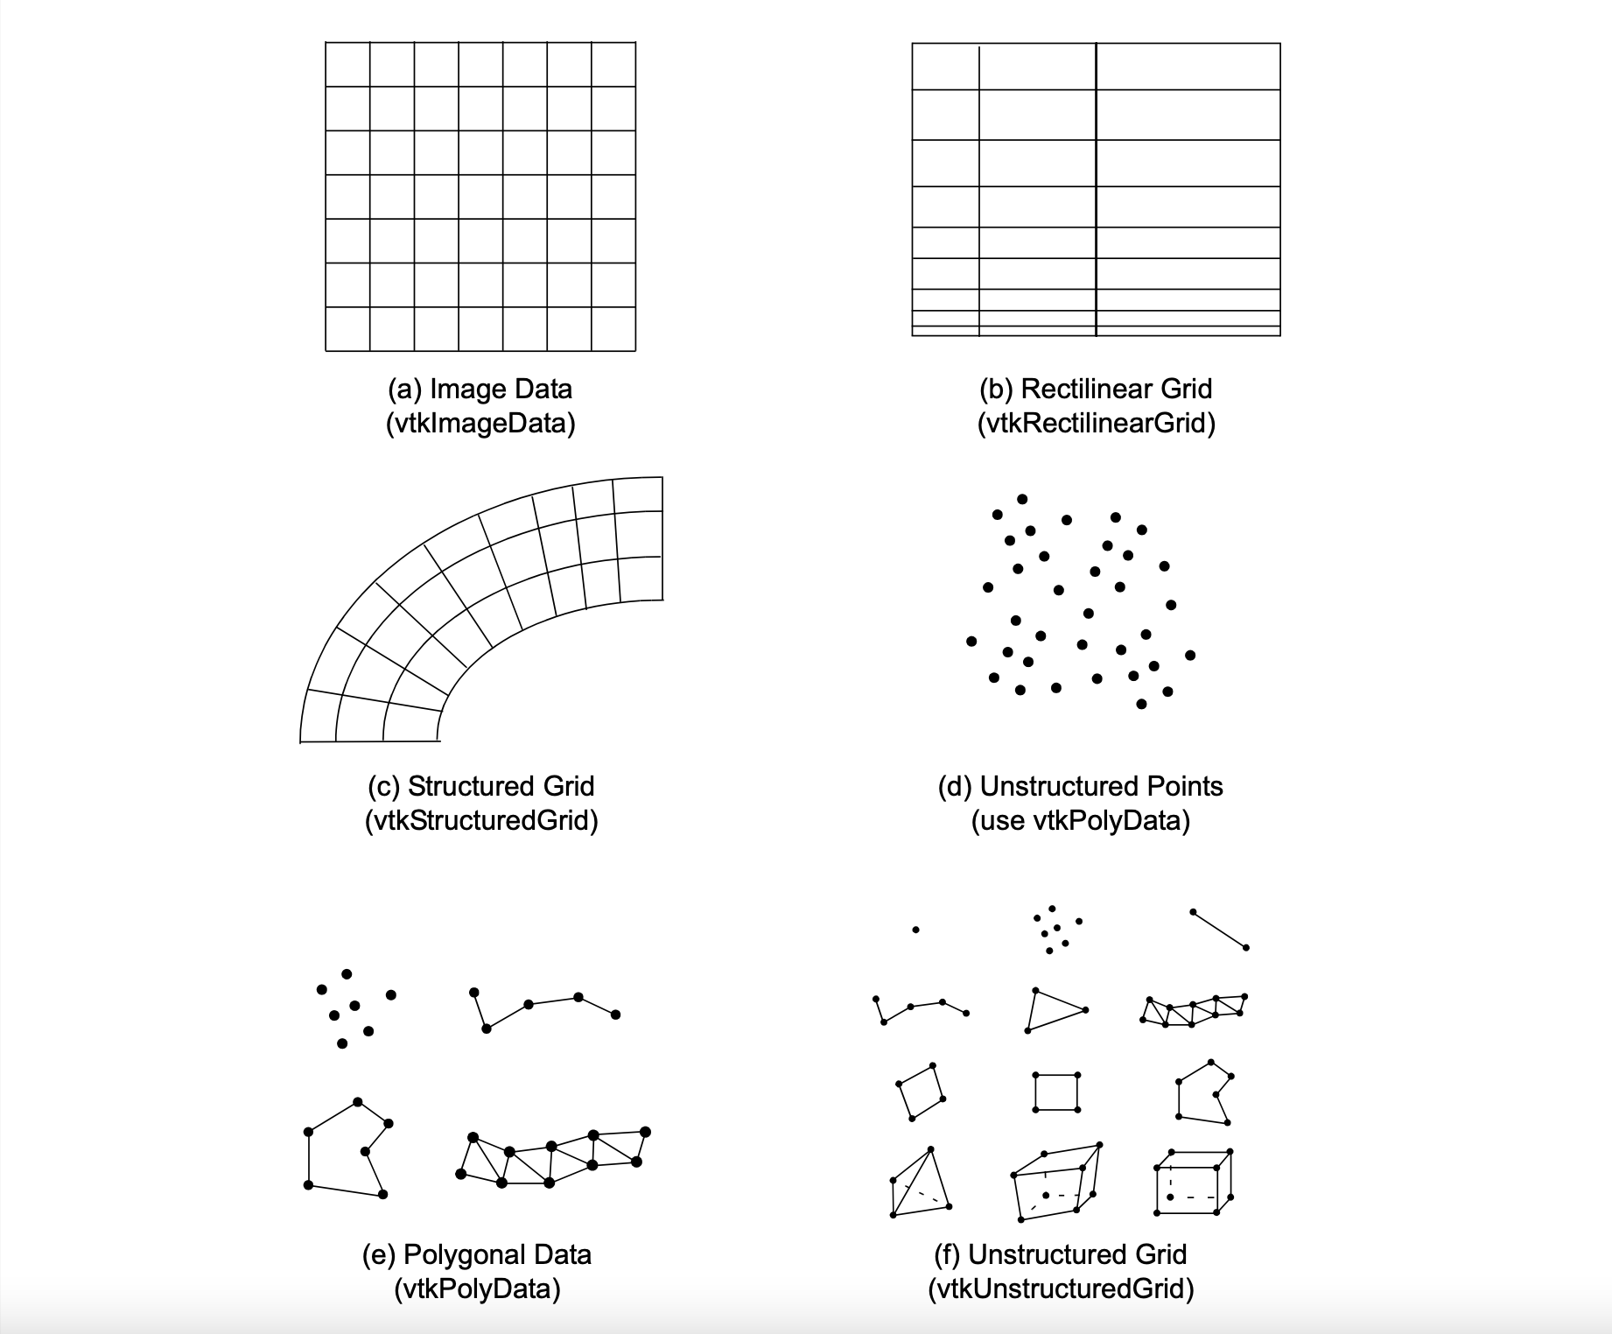
VTK Data Types

Slide 38
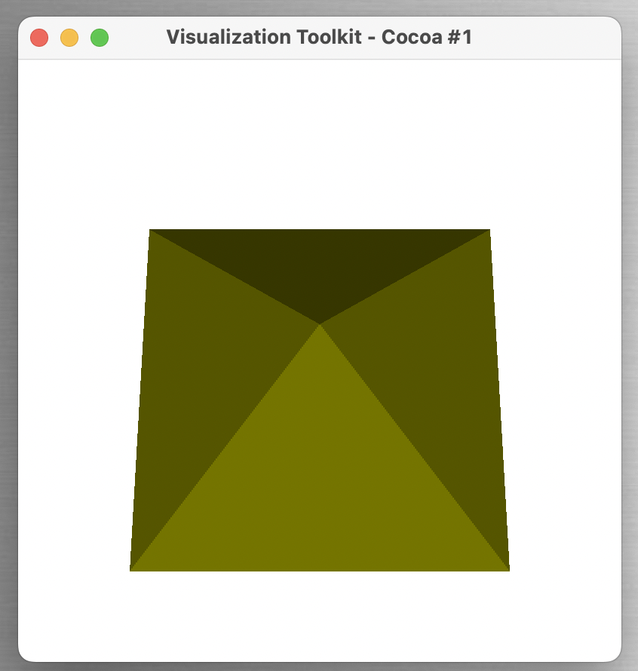
VTK Pipeline Execution
Source
Filter
Direction of data flow
Mapper
Actor
Renderer
Render Window

Slide 39
VTK Pipeline Execution: Source
Source
Source indicates the dataset source
Involves data loader of various types
Uniform, structured, rectilinear, etc.
Filter
Direction of data flow
Mapper
Actor
Renderer
Render Window

Slide 40
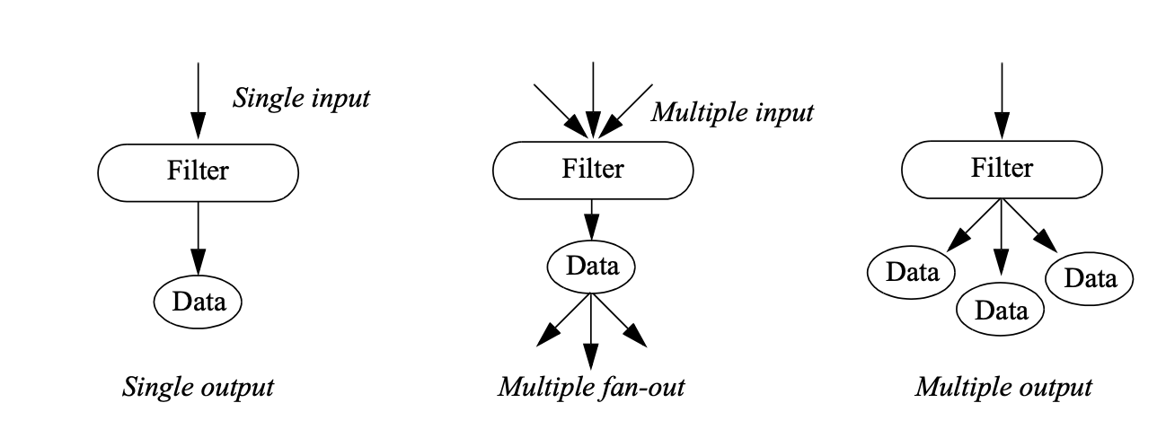
VTK Pipeline Execution: Filter
Source
Filters are another name of algorithms in VTK
threshold, connected component, surface extraction, volume render, etc.
Filter
Direction of data flow
Mapper
Actor
Renderer
Render Window

Slide 41
VTK Pipeline Execution: Mapper
Source
Mappers convert data into graphical primitives
Mappers require one or more input data objects, output from Filters
Example: vtkPolyDataMapper, which takes geometry such as cylinder or cone as input and convert it to renderable geometry
Filter
Direction of data flow
Mapper
Actor
Renderer
Render Window

Slide 42
VTK Pipeline Execution: Actor
Source
Actors represent graphical data or objects with various properties for rendering
A VTK actor contains
object properties (color, shading type, etc.)
geometry
transformations
VTK actors need to work together with lights (vtkLight) and camera (vtkCamera) to make a scene
Filter
Direction of data flow
Mapper
Actor
Renderer
Render Window

Slide 43
VTK Pipeline Execution: Renderer
Source
vtkRenderer coordinates the rendering process involving lights, camera, and actors
vtkRenderer creates a default camera and light if not present, but needs to have at least one actor
Filter
Direction of data flow
Mapper
Actor
Renderer
Render Window

Slide 44
VTK Pipeline Execution: Render Window
Source
The class, vtkRenderWindow ties the entire rendering process together
Manages all the platform dependent window management issues and hide the details from the user
Filter
Direction of data flow
Mapper
Actor
Renderer
Render Window

Slide 45
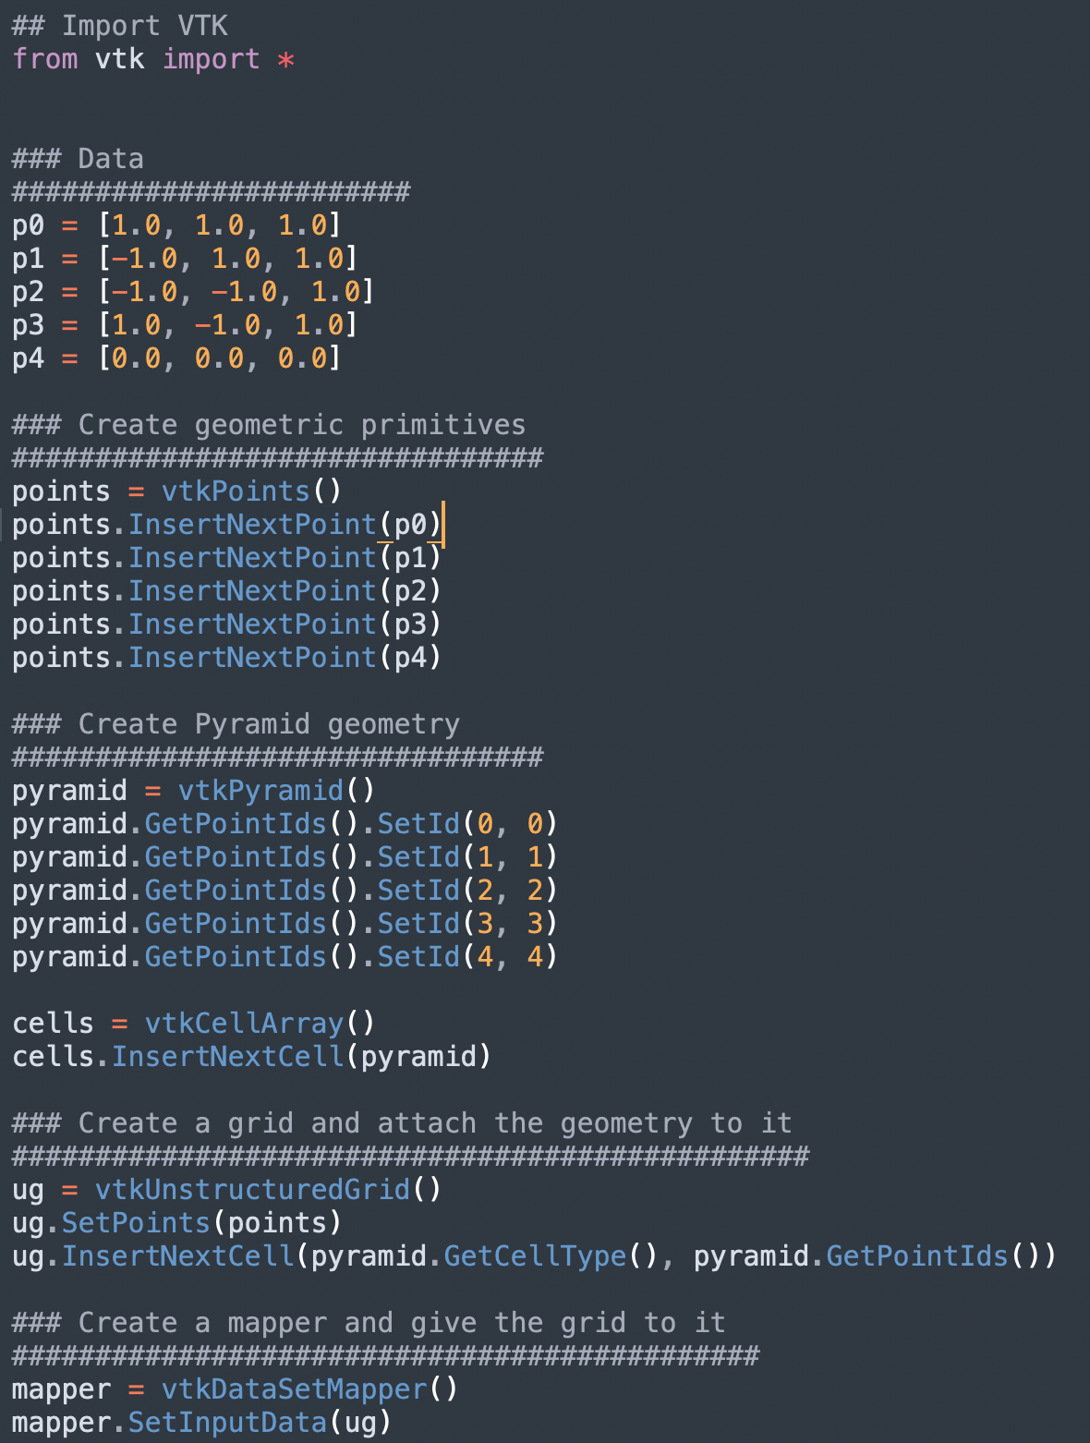
A Simple VTK Program

Slide 46
A Simple VTK Program

Slide 47
A Simple VTK Program

Slide 48
A Simple VTK Program

Slide 49
A Simple VTK Program

Slide 50
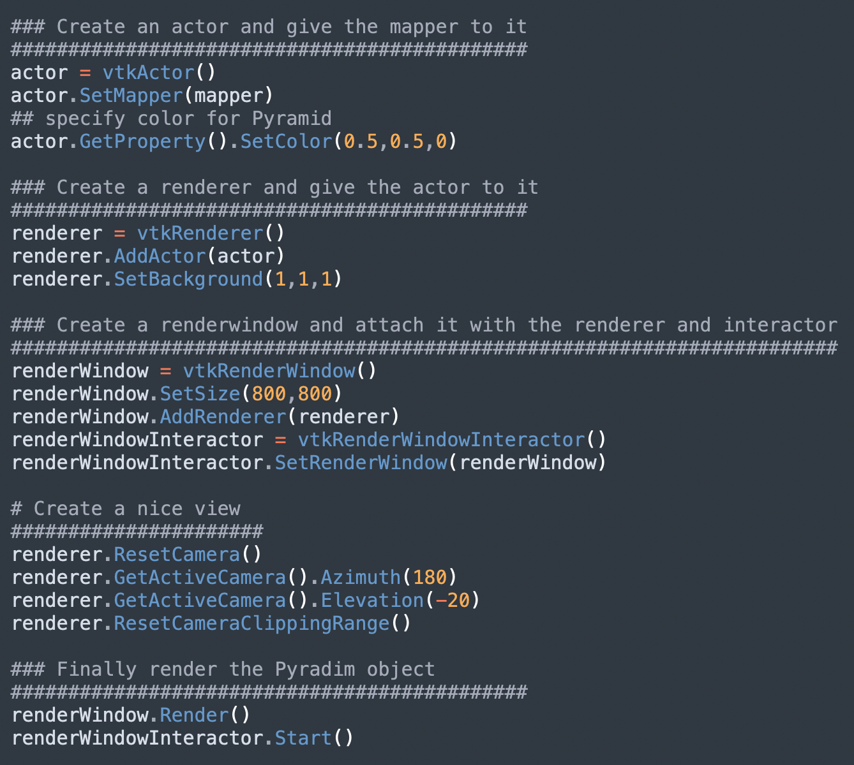
A Simple VTK Program

Slide 51
A Simple VTK Program

Slide 52
A Simple VTK Program

Slide 53
A Simple VTK Program

Slide 54
A Simple VTK Program

Slide 55
A Simple VTK Program
$> Python Pyramid.py
Demo

